Slide 1

Norwegian University of Life Sciences
Zakhar Maletskyi & Elisabeth Hoff
Kick-off meeting, Niš / 21 December 2018
This project has been funded with support from the European Commission. This publication reflects the views only of the author, and the Commission cannot be held responsible for any use which may be made of the information contained therein.

Slide 2

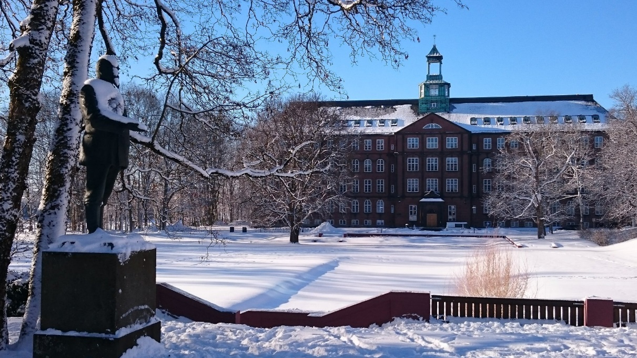
Norwegian University of Life Sciences (NMBU)
One of 8 universities in Norway
Founded in 1859
Over 5200 students – 17% international students
1700 staff members
7 faculties
65 study programs – Water and Environmental Technology
Håkon Sparre/NMBU
NMBU focus areas
Environment
Sustainable development
Climate challenges
Renewable energy sources
…..
Knut Einar Rosendahl
Strengthening of master curricula in water resources management
for the Western Balkans HEIs and stakeholders
www.swarm.ni.ac.rs

Slide 3
Water Harmony initiative
8 Teaching Members (Prof, Ass Prof)
3 Research Coordinators (Post Docs & Research Ass)
14 PhD students
60 MSc students
2 Project Coordinators
Conferences & workshops
IWA, EWA
NATO
Teaching
Industrial collaboration
knowledge transfer
International outlook
Research
Bilateral
Africa & Asia
Living Labs
Eurasia
North America ++
Consortial

Slide 4
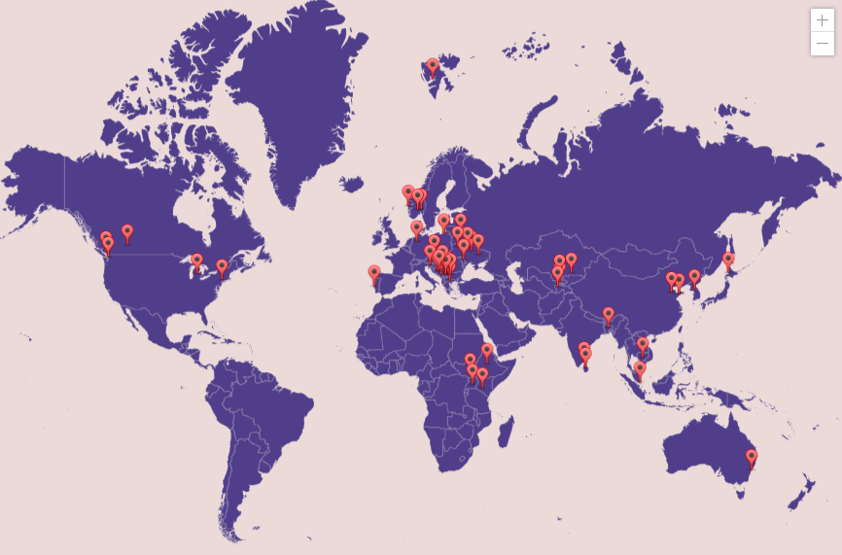
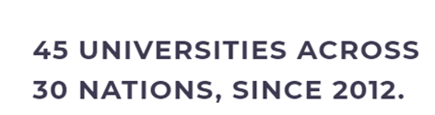
Water Harmony geography
Strengthening of master curricula in water resources management
for the Western Balkans HEIs and stakeholders
www.swarm.ni.ac.rs

Slide 5






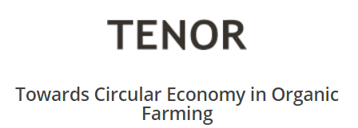
Active coordinated projects
EU, Eurasia, Asia
New
EUR1,3 mill
EUR 1,5 mill
AECo
Advancing Electrocoagulation
for water safety and circularity
Eurasia
Industrial Countries
Africa & Asia
Approx. EUR 3 mill

Slide 6
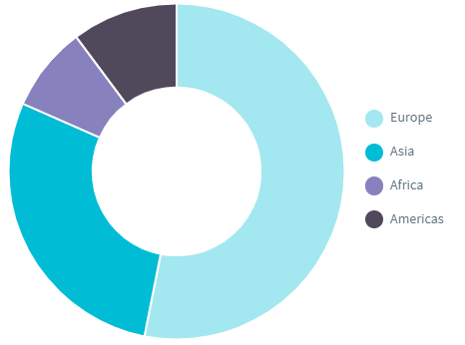

Water Harmony
Partners
Strengthening of master curricula in water resources management
for the Western Balkans HEIs and stakeholders
www.swarm.ni.ac.rs

Slide 7
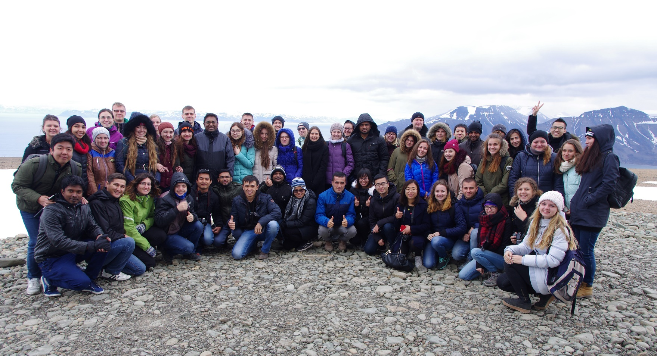
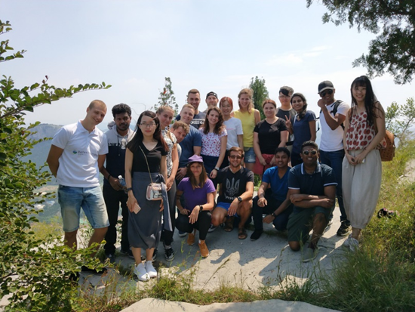
International Water Summer School – every year
since 2012 in Norway
2018 – first time in China
Strengthening of master curricula in water resources management
for the Western Balkans HEIs and stakeholders
www.swarm.ni.ac.rs

Slide 8



Conferences and workshops with IWA, EWA and NATO
22-24 June 2016 - IWA Particle Separation Conference, Oslo, Norway - https://www.ccnorway.no/iwa2015/
25-27 June 2016 – EWA Water Management in Cold Climate, Longyearbyen, Norway - https://www.ccnorway.no/iwasvalbard/
8-11 October 2018 - Workshop on Physical and Cyber Safety in Critical Water Infrastructure, Oslo, Norway - https://www.natoarw-cyberwater.net/
Strengthening of master curricula in water resources management
for the Western Balkans HEIs and stakeholders
www.swarm.ni.ac.rs

Slide 9



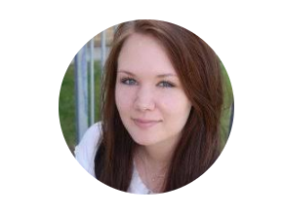
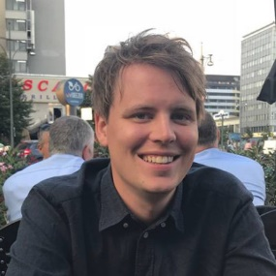
Project group
Prof. Harsha Ratnaweera Dr. Zakhar Maletskyi Dr. Arve Heistad
Ms. Elisabeth Hoff
Mr. Åsmund Skaar
Strengthening of master curricula in water resources management
for the Western Balkans HEIs and stakeholders
www.swarm.ni.ac.rs

Slide 10
Education, research potential and practices
Experience from
Strengthening of master curricula in water resources management
for the Western Balkans HEIs and stakeholders
www.swarm.ni.ac.rs

Slide 11
Teaching
Strengthening of master curricula in water resources management
for the Western Balkans HEIs and stakeholders
www.swarm.ni.ac.rs

Slide 12
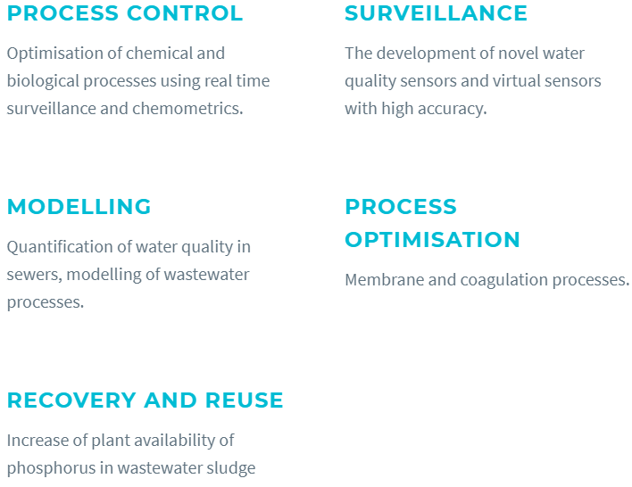
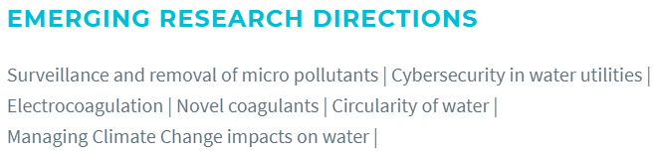
Research
Strengthening of master curricula in water resources management
for the Western Balkans HEIs and stakeholders
www.swarm.ni.ac.rs

Slide 14






10 universities from 6 countries
University of Warmia and Mazury, Olsztyn, Poland
University of Applied Science Ostwestfalen-Lippe, Höxter, Germany
National Technical University of Ukraine KPI, Kiev, Ukraine
Ukrainian State Uni. of Chemical Technology, Dnepropetrovsk
Cherkassy State Technological University, Cherkassy, Ukraine
University of Jaffna, Jaffna, Sri Lanka
University of Peradeniya, Peradeniya, Sri Lanka
Shandong Jianzhu University, Jinan, China
Qingdao Technological University, Qingdao, China
Norwegian University of Life Sciences, Norway
Strengthening of master curricula in water resources management
for the Western Balkans HEIs and stakeholders
www.swarm.ni.ac.rs

Slide 15
Objectives
Develop learning and teaching tools, methodologies and pedagogical approaches on 6 courses related to water
Upgrade laboratories together with lab courses and teaching tools, so that graduates are more attractive and suitable to their future employers.
Develop e-learning modules using the resources from newly developed courses
Train staff to think more from a user perspective, creating better opportunities for graduates and opportunities for contract research
Train staff to think multi-purpose utilization of resources and opportunities to enhance enterprise collaborations
Strengthen entrepreneurship skills both for students and staff as a tool for securing financial sustainability
Secure quality assurance of educational programs facilitating credit transfers
Dissemination of project results and success stories motivating non-partners to adopt project results
Strengthening of master curricula in water resources management
for the Western Balkans HEIs and stakeholders
www.swarm.ni.ac.rs

Slide 16

Generic curricula
Needs analysis
Course reviewers
Harmonisation
Testers
6 courses
4 technical subjects
Academic writing
Innovation & Entrepreneurship
Course editors
Upgrade of labs
Support of lab course
BSc & MSc studies
Resource persons - contributors
Strengthening of master curricula in water resources management
for the Western Balkans HEIs and stakeholders
www.swarm.ni.ac.rs

Slide 17
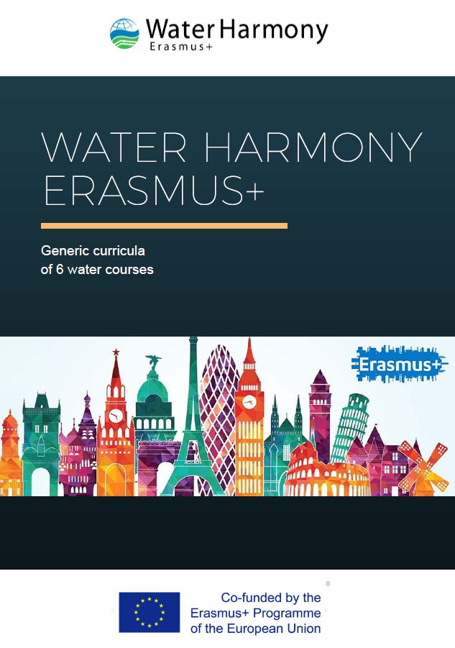
Generic curricula – products
Generic curricula
Teaching materials (lectures)
Lab manual
Student placement manual
Workshops
Supervision handbook (adopted)

Slide 18
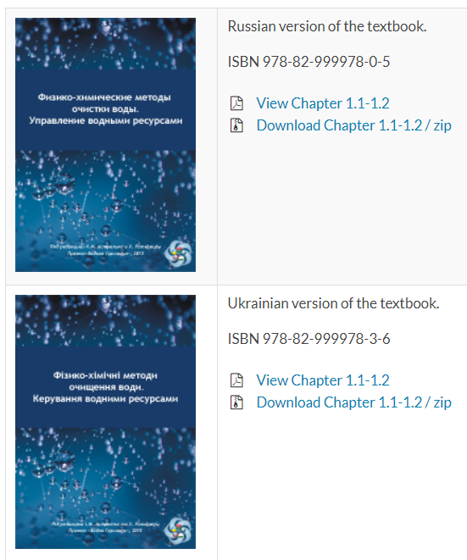
Water Harmony textbook
Country/region specific chapters
7 Languages
  Russian
  Ukrainian
  Tajik
  Kazakh
  Belarusian
  Kyrgyz
  Romanian (Moldova)

Slide 19

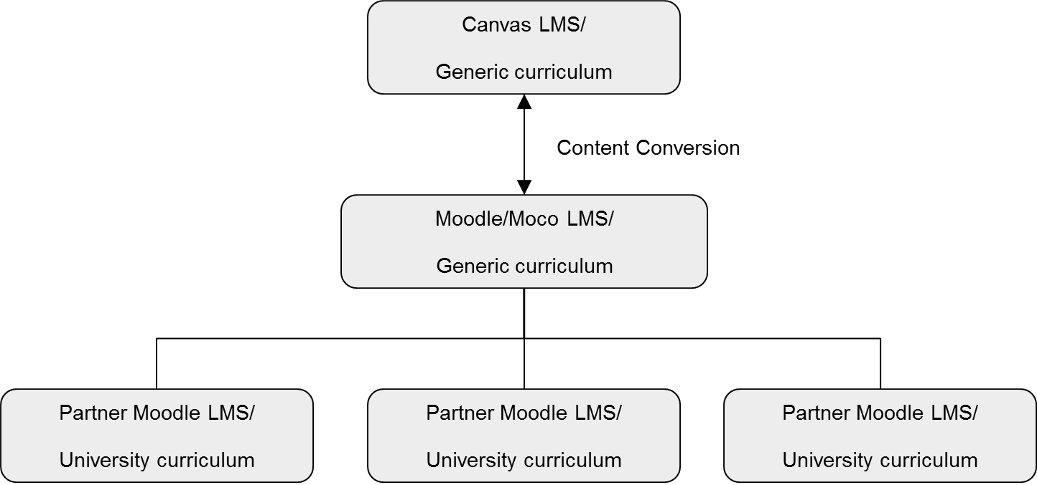
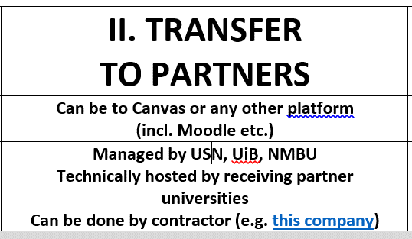
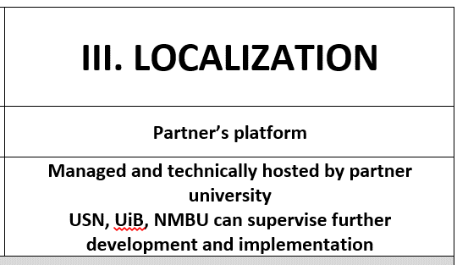
E-learning development
Strengthening of master curricula in water resources management
for the Western Balkans HEIs and stakeholders
www.swarm.ni.ac.rs

Slide 20
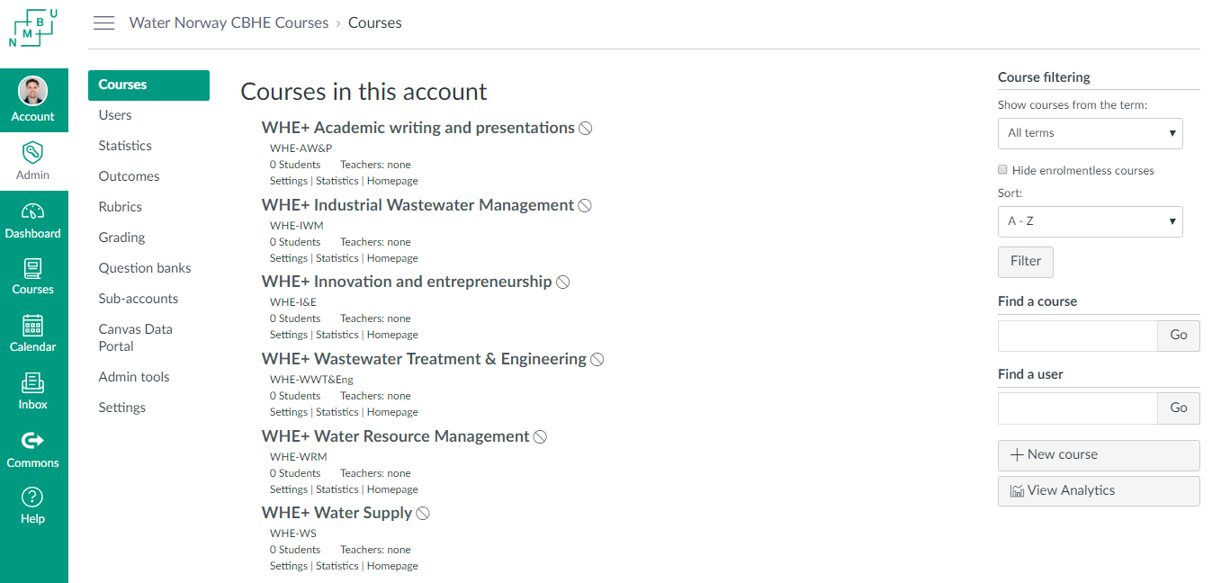
6 courses structure
Strengthening of master curricula in water resources management
for the Western Balkans HEIs and stakeholders
www.swarm.ni.ac.rs

Slide 21
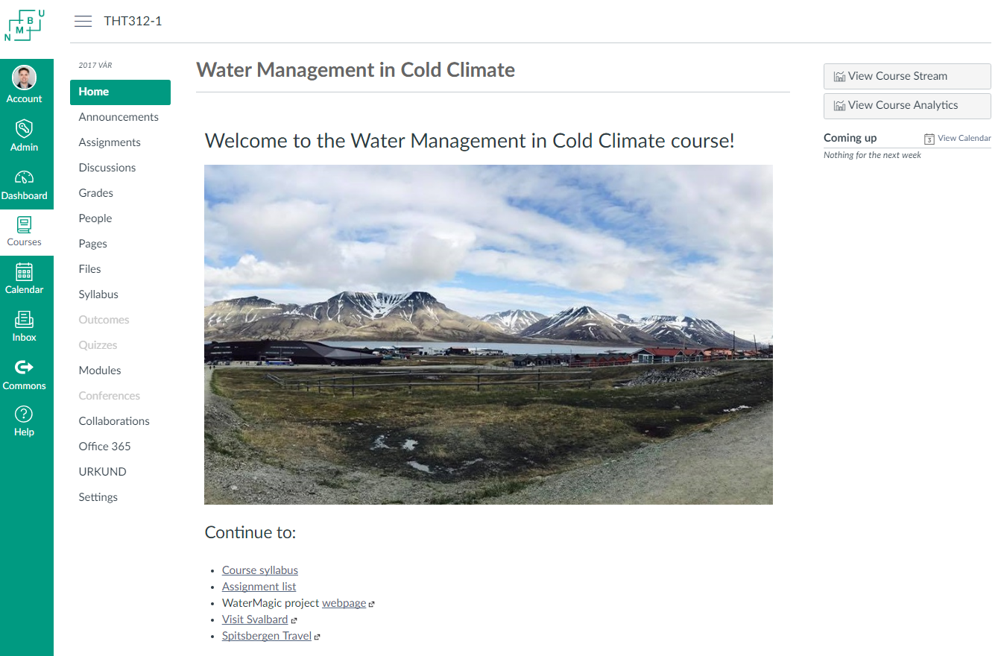
Testing by students and teachers
Strengthening of master curricula in water resources management
for the Western Balkans HEIs and stakeholders
www.swarm.ni.ac.rs

Slide 22
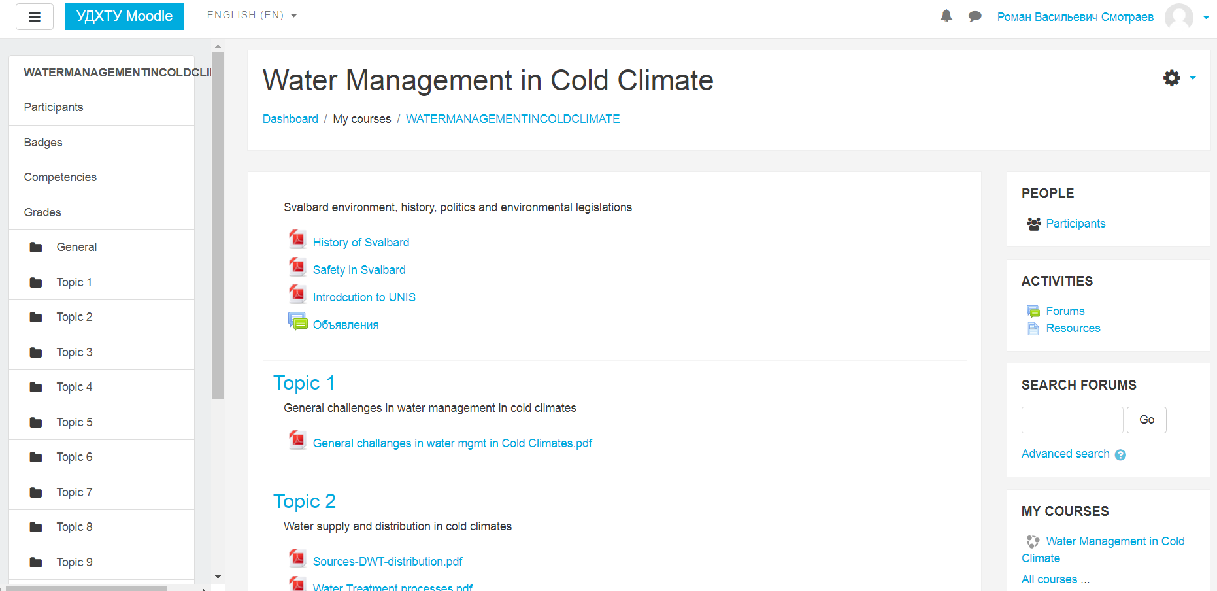
Export to partners
Strengthening of master curricula in water resources management
for the Western Balkans HEIs and stakeholders
www.swarm.ni.ac.rs

Slide 23


Project management
Board of coordinators
Secretaries group
Resource persons
Activity leaders
Project meetings
Minutes and work plan
Online meetings
  Coordinators
  Secretaries
Task progress control
Strengthening of master curricula in water resources management
for the Western Balkans HEIs and stakeholders
www.swarm.ni.ac.rs

Slide 24
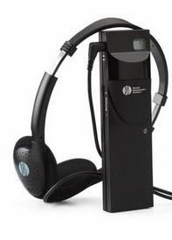
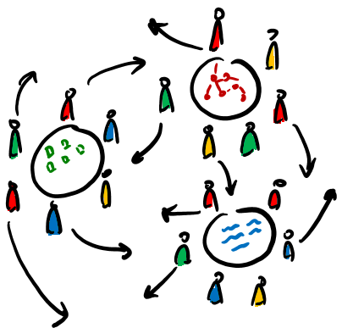

Creative solutions
Working with language barrier
Group creative techniques
Cross-project evaluation
Strengthening of master curricula in water resources management
for the Western Balkans HEIs and stakeholders
www.swarm.ni.ac.rs

Slide 25
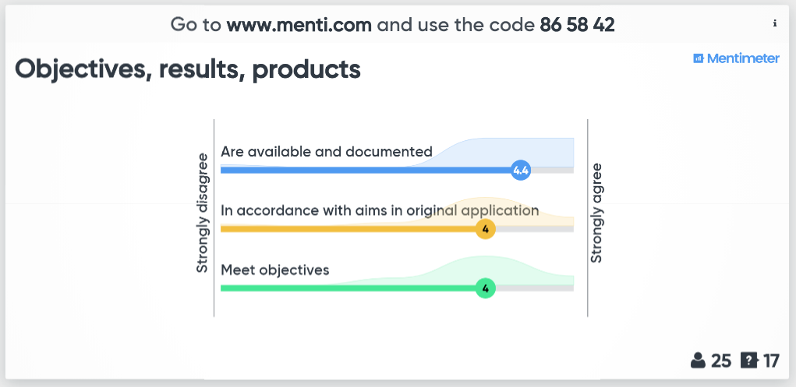
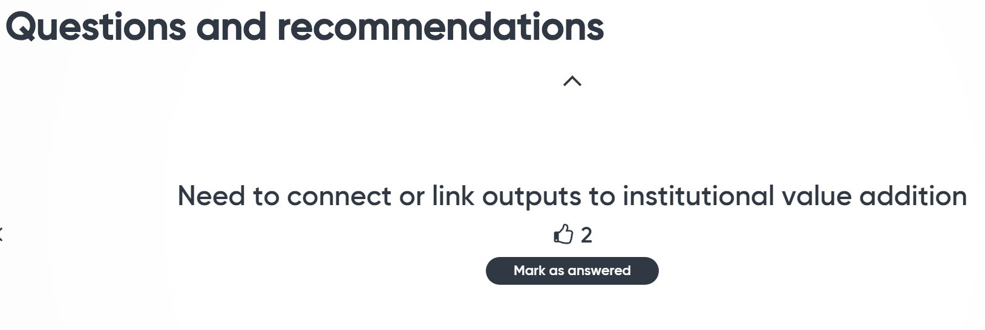
Cross-project evaluation
Strengthening of master curricula in water resources management
for the Western Balkans HEIs and stakeholders
www.swarm.ni.ac.rs

Slide 26
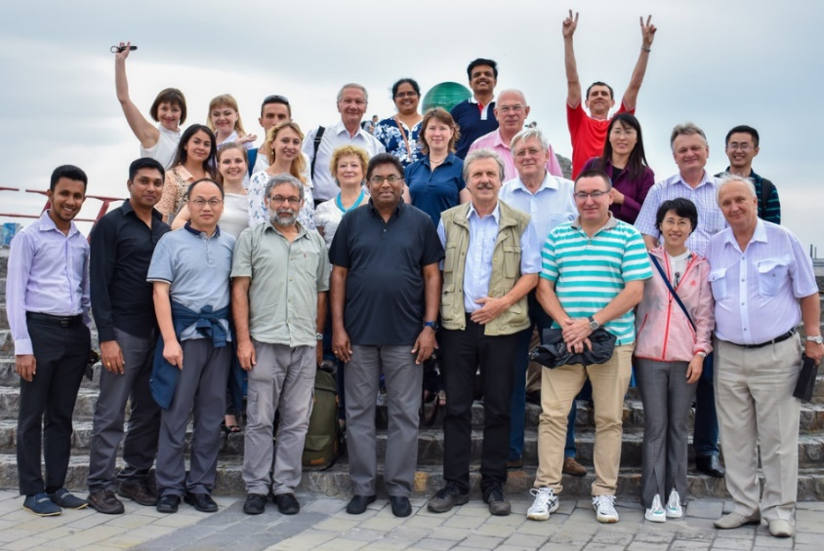
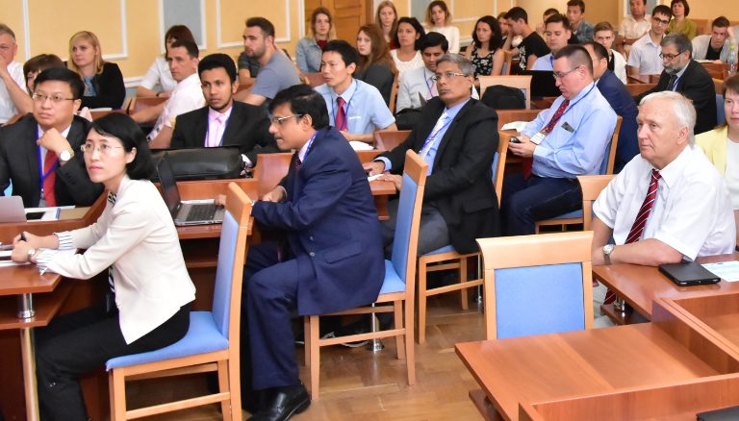
Project meetings
2 persons from each partner, 3-4 working days.
Oslo, Norway, 11/2015 Kandy, Sri Lanka, 03/2016 Kiev, Ukraine 05/2016 Olsztyn, Poland 09/2016 Qingdao, China 12/2016 Höxter, Germany 04/2017 | Cherkassy, Ukraine, 07/2017 Jinan, China, 11/2017 Jaffna, Sri Lanka 02/2018 Dnepro, Ukraine 06/2018 Ås, Norway 10/2018
Strengthening of master curricula in water resources management
for the Western Balkans HEIs and stakeholders
www.swarm.ni.ac.rs

Slide 27
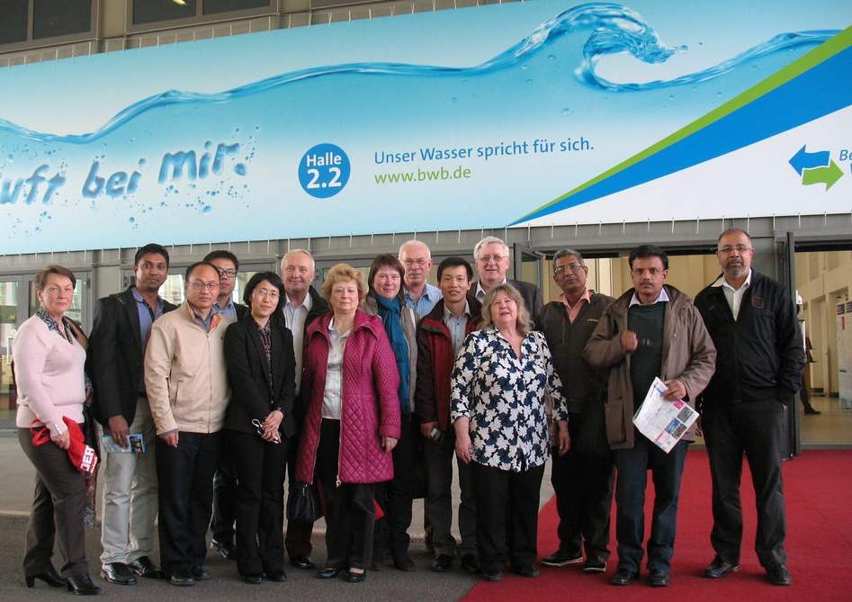
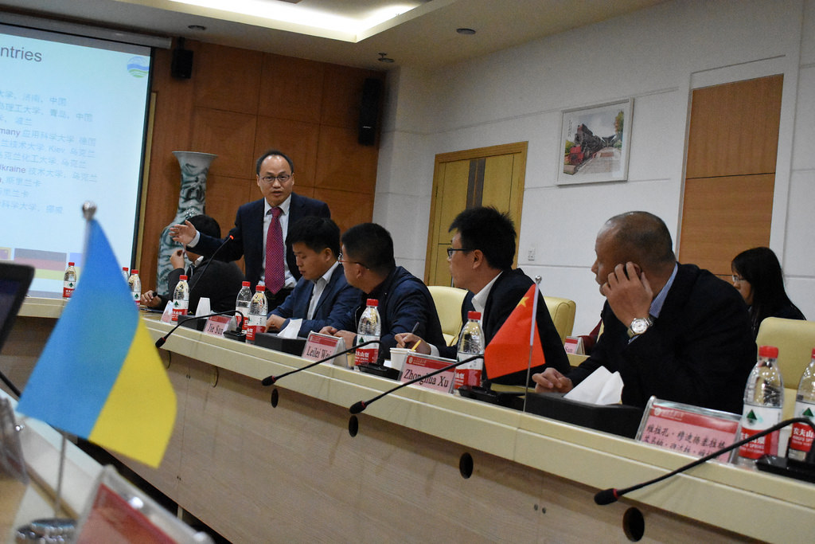
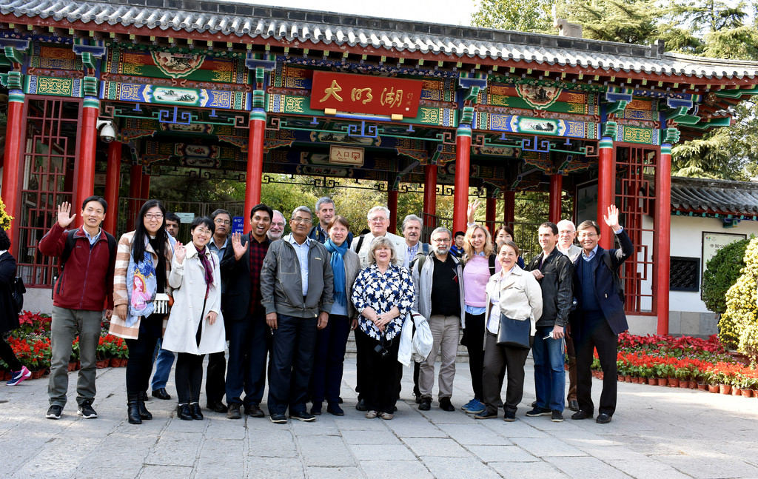
Strengthening of master curricula in water resources management
for the Western Balkans HEIs and stakeholders
www.swarm.ni.ac.rs

Slide 28
Student and staff mobility
Category | From | To | Number | When | Duration
Staff | NO, PL, DE | UA-DN | 2x3univ | 06/2016 | 1 week
Staff | NO, PL, DE | UA-KPI | 2x3univ | 06/2017 | 1 week
Staff | NO, PL, DE | UA-CHER | 2x3univ | 06/2018 | 1 week
Staff | UA x 3 univ | NO, PL, DE | 2x3univ | 06/2016 | 1 week
Staff | UA x 3 univ | NO, PL, DE | 2x3univ | 06/2017 | 1 week
Staff | UA x 3 univ | NO, PL, DE | 2x3univ | 06/2018 | 1 week
Student | all | NMBU | 3x10 univ |  | 3 weeks
Student | all | SL-UOP | 2x10 univ |  | 3 weeks
Student | all | CN-QTU | 2x10 univ |  | 3 weeks
Student | UAx3 | NMBU | 4+4+3 | 09/2016 | 1 year
Student | UAx3 | PL-UMW | 2+2+2 | 09/2017 | 1 year
Student | UAx3 | NMBU | 2+2+2 | 09/2017 | 1 year
Student | NO, PL, DE | UA-KPI | 2+2+2 | 01/2017 | 5 months
Student | NO, PL, DE | UA-DN | 2+2+2 | 01/2017 | 5 months
Student | NO, PL, DE | UA-CHER | 2+2+2 | 01/2017 | 4-5 months
Strengthening of master curricula in water resources management
for the Western Balkans HEIs and stakeholders
www.swarm.ni.ac.rs

Slide 29
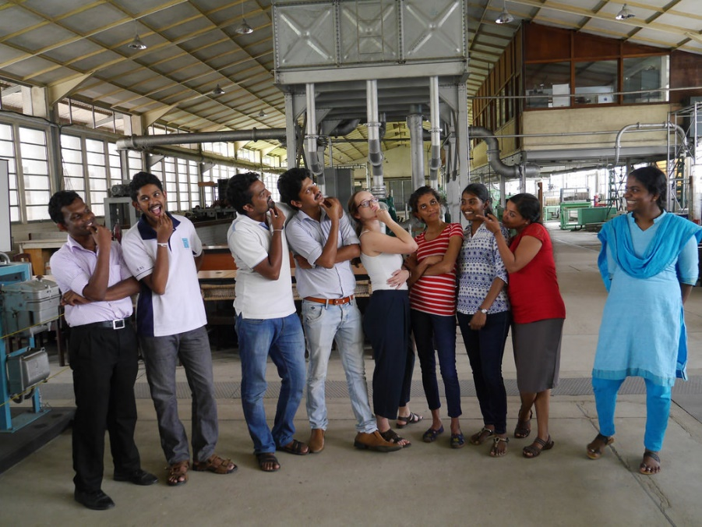
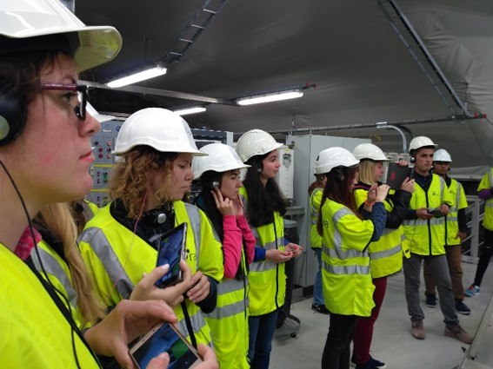
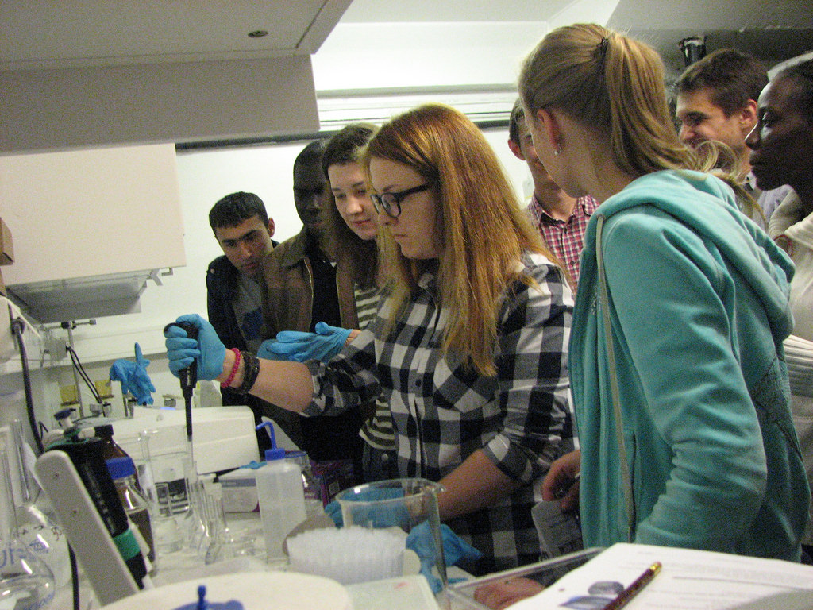
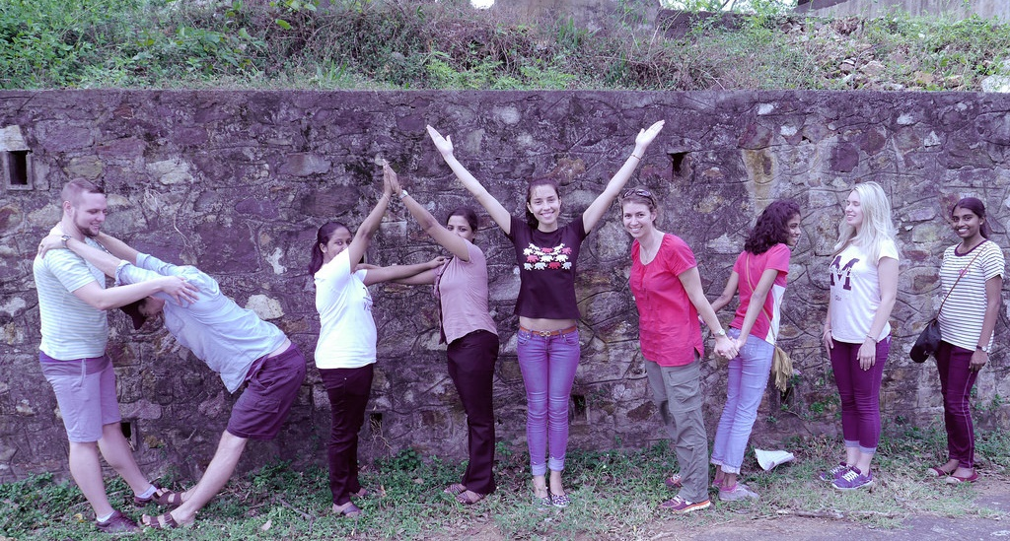
Strengthening of master curricula in water resources management
for the Western Balkans HEIs and stakeholders
www.swarm.ni.ac.rs

Slide 30
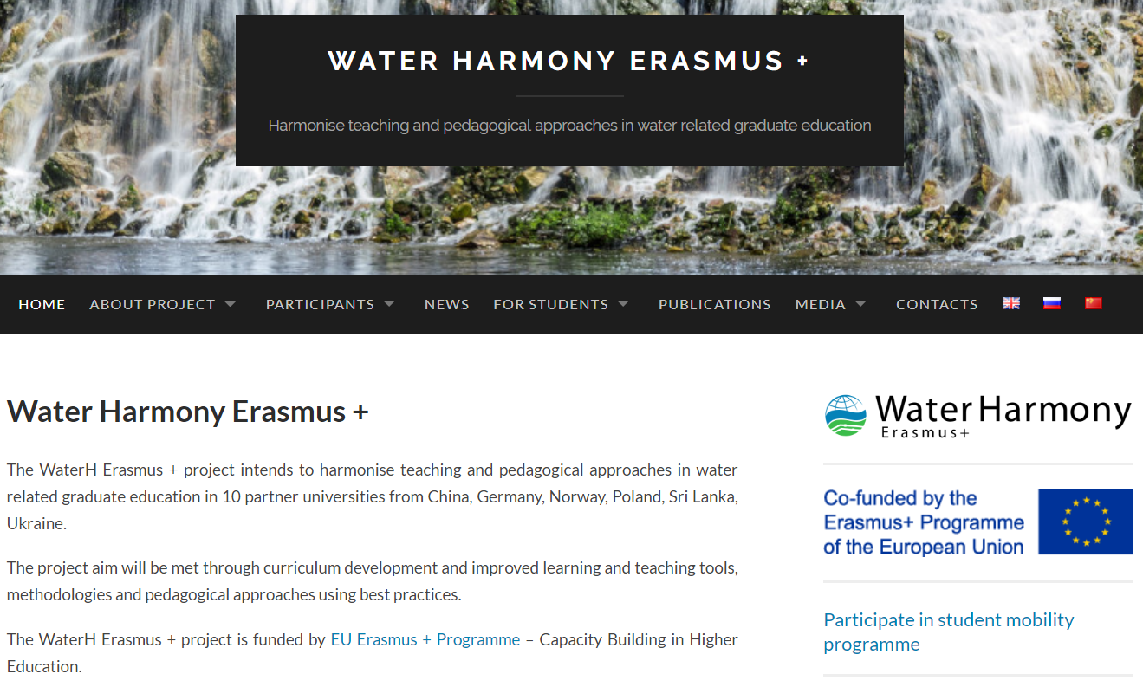
Dissemination & exploitation
Priority channel – digital:
  Webpage
  Social networks
Printed media
Project publications
Strengthening of master curricula in water resources management
for the Western Balkans HEIs and stakeholders
www.swarm.ni.ac.rs

Slide 31
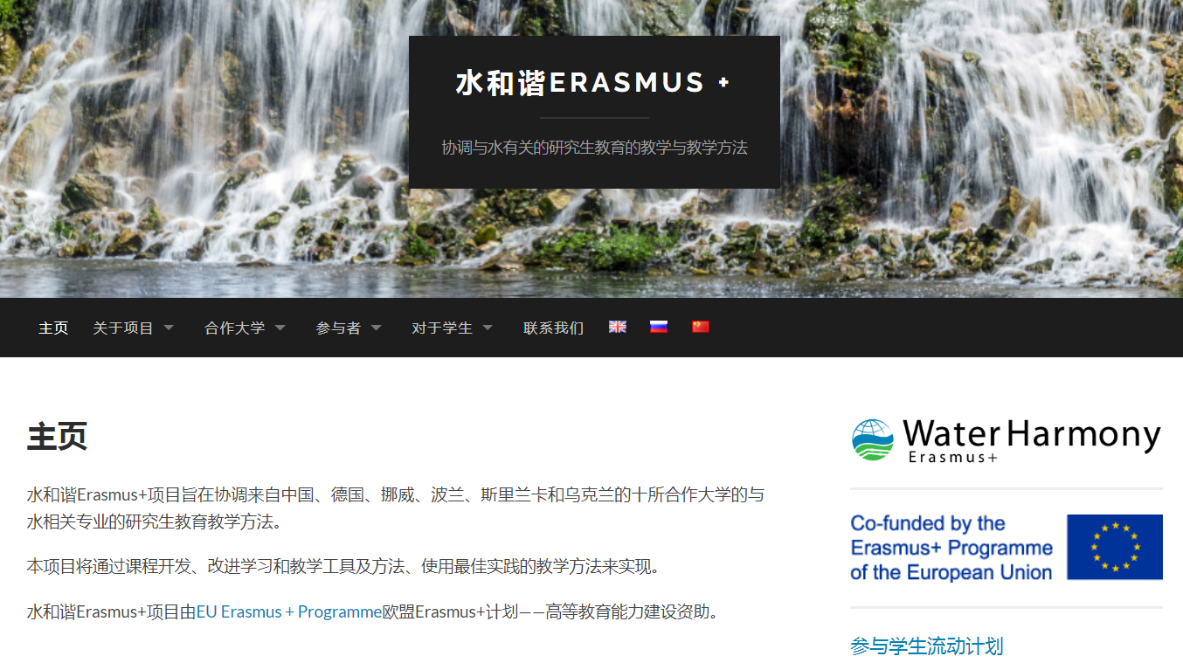
Dissemination & exploitation
Strengthening of master curricula in water resources management
for the Western Balkans HEIs and stakeholders
www.swarm.ni.ac.rs

Slide 32
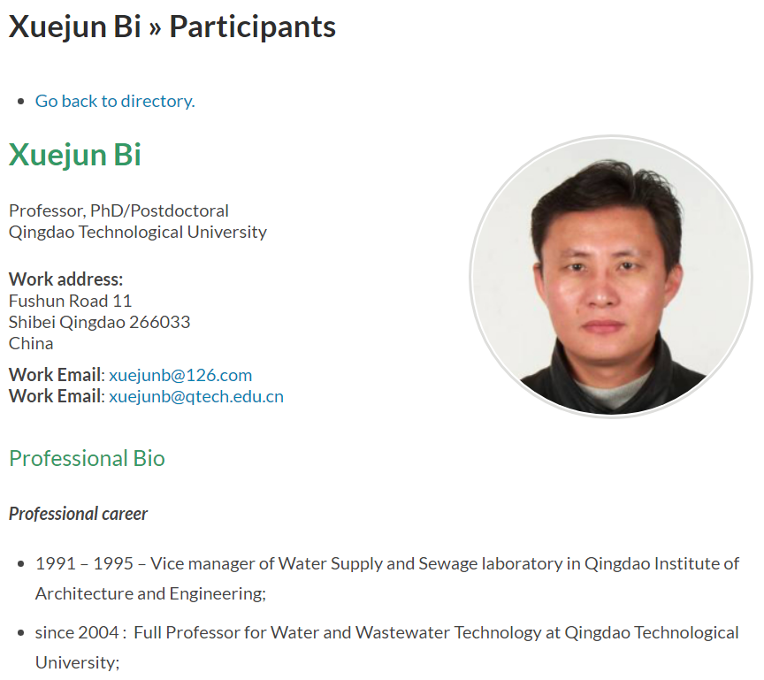
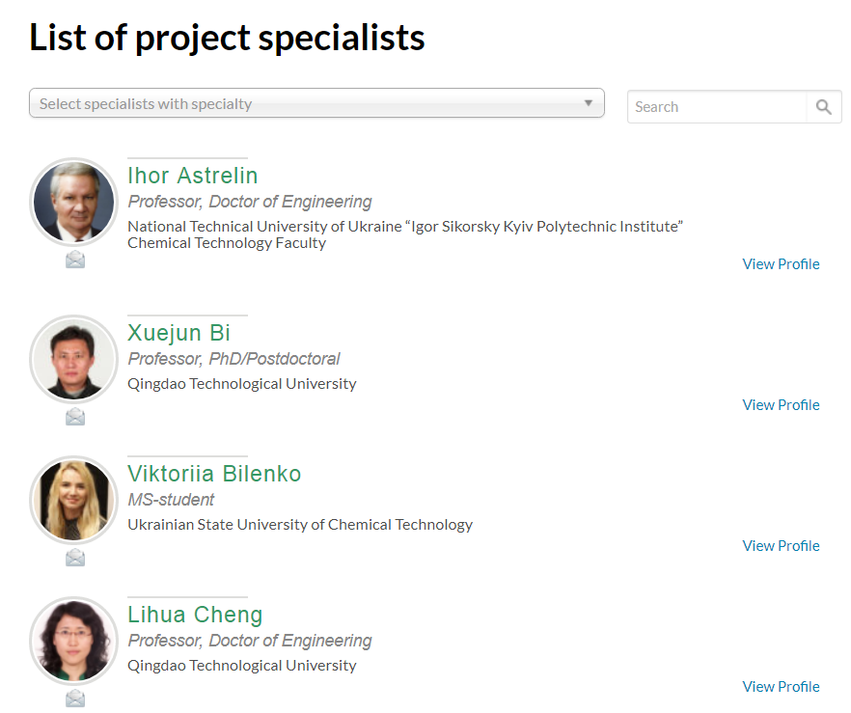
Dissemination & exploitation
Connectivity tool
Strengthening of master curricula in water resources management
for the Western Balkans HEIs and stakeholders
www.swarm.ni.ac.rs

Slide 33
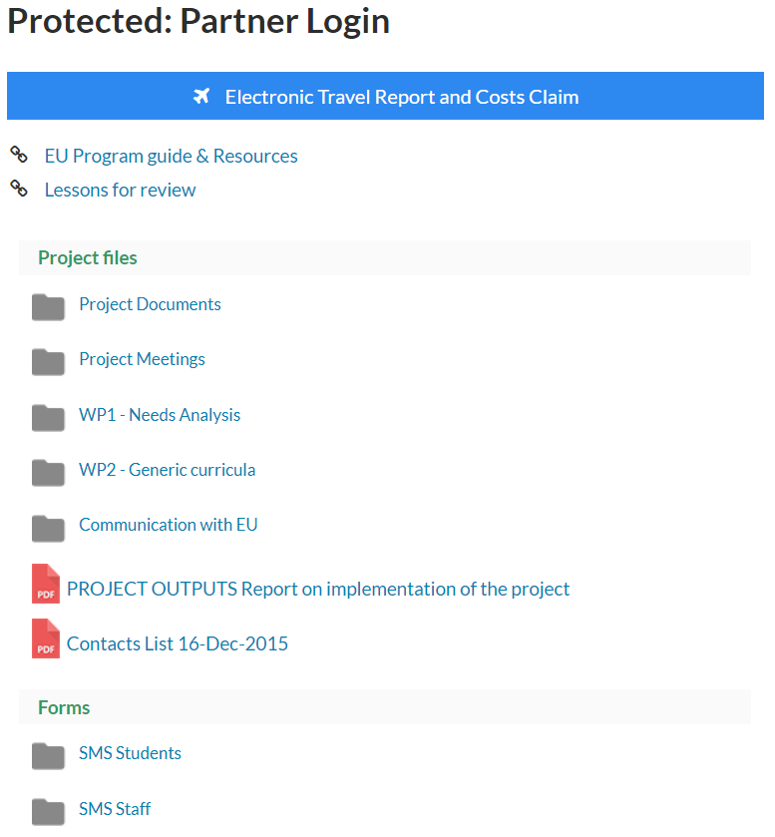
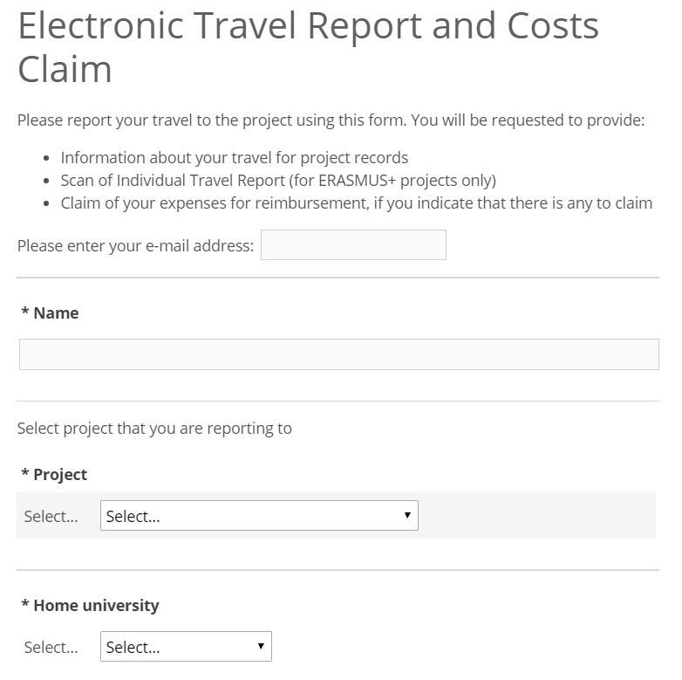
Dissemination & exploitation
Internal communications instrument
Strengthening of master curricula in water resources management
for the Western Balkans HEIs and stakeholders
www.swarm.ni.ac.rs

Slide 34
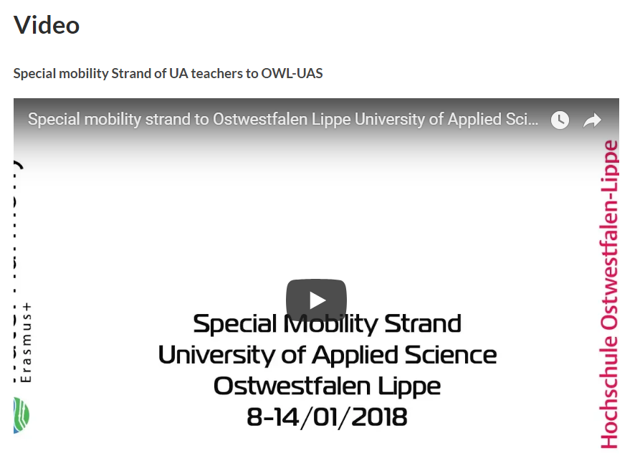
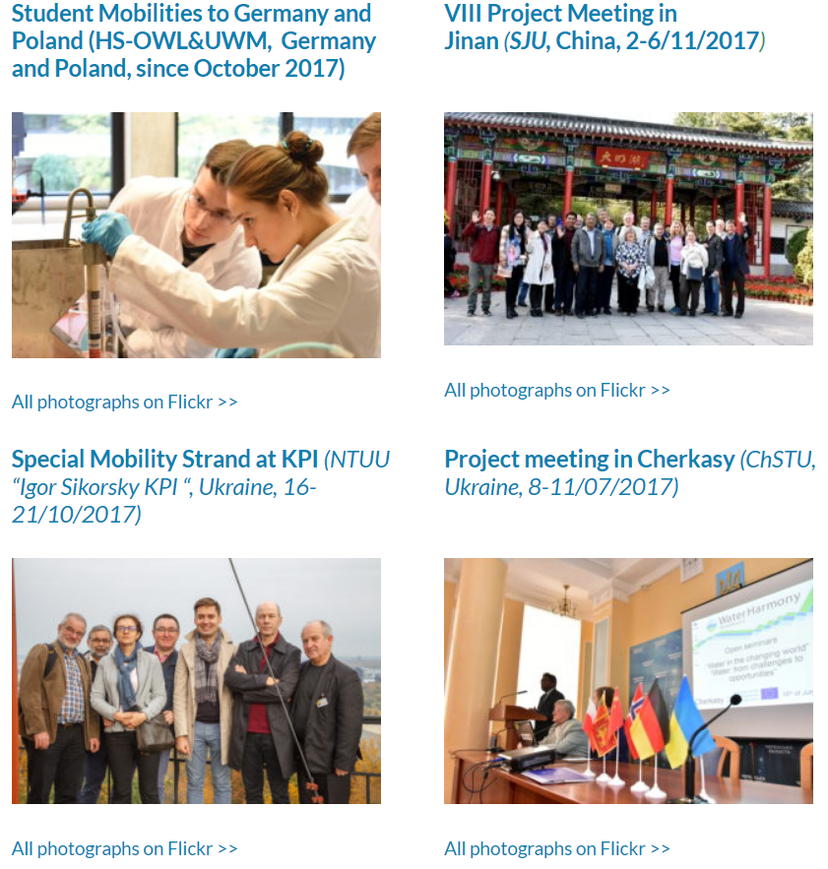
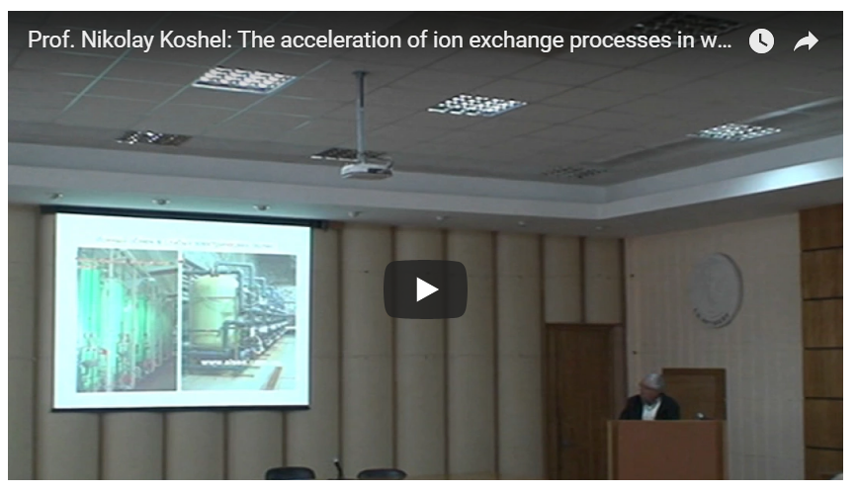
Dissemination & exploitation
Flickr – photos, video & lectures
Strengthening of master curricula in water resources management
for the Western Balkans HEIs and stakeholders
www.swarm.ni.ac.rs

Slide 35

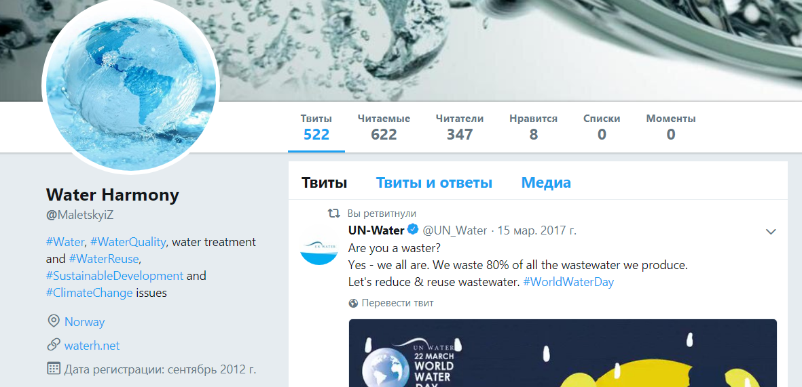
Social networks
Strengthening of master curricula in water resources management
for the Western Balkans HEIs and stakeholders
www.swarm.ni.ac.rs

Slide 36




Slide 37



